Slide 1


Analysis of Employee Attrition at Frito Lay
Understanding Key Factors Contributing to Employee Turnover
March 2025
Devin Streeter

Slide 2

Goals
Identify key drivers of Employee attrition.

Slide 3
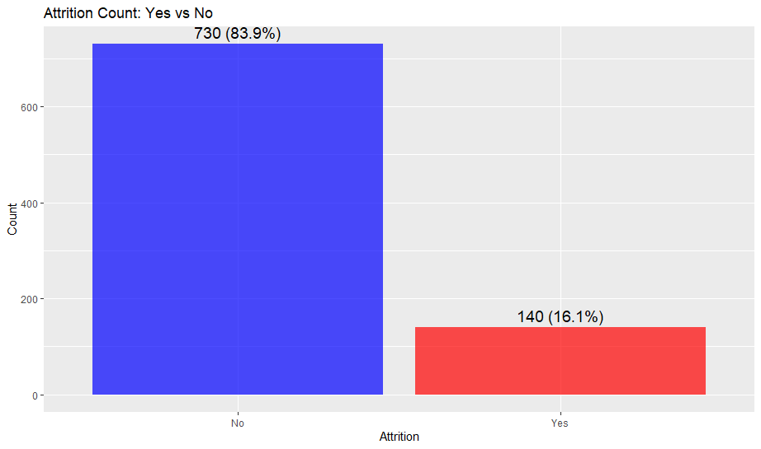
Overview
Number of employees: 870
Number of variables: 36
Key Features:
Demographics (Age, Distance From Home)
Compensation (Monthly Income, Stock Option Level)
Job-related (Job Role, Overtime)
The average annual salary for ALL employees is $76,683.17
Attrition is estimated to cost $6,441,386.48 in this dataset.

Slide 4
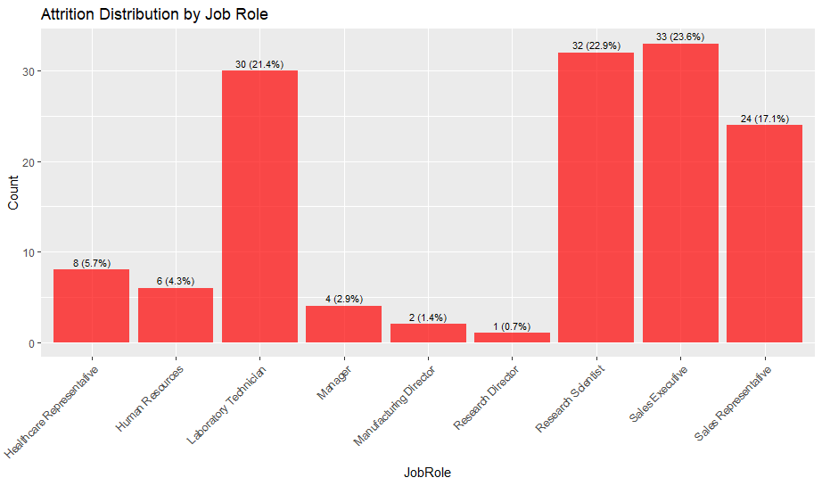
Job Roles

Slide 5
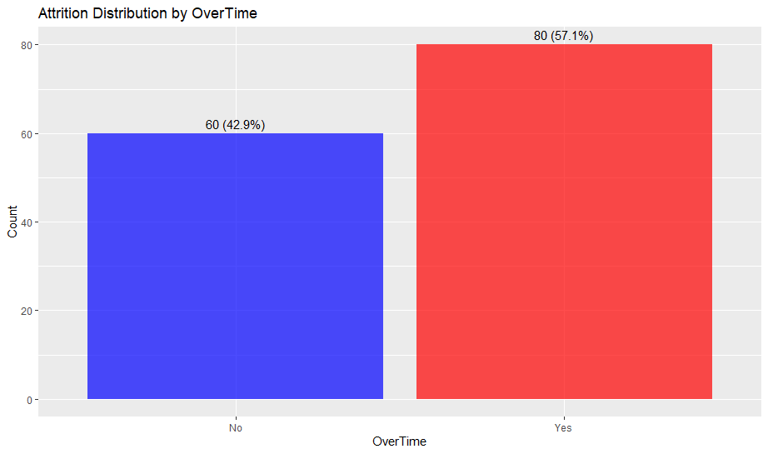
Overtime
Employees working overtime are more likely to leave.
Potential overlap with Work Life Balance category.

Slide 6
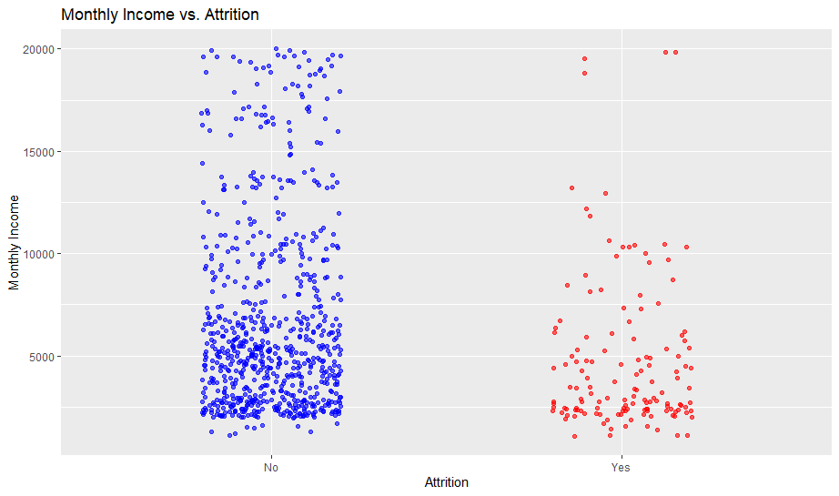
Monthly Income
The average income of an employee lost to attrition was $4,764.79.
The average income of an employee not lost to attrition was $6,702.
Employees with lower salaries tend to leave more.

Slide 7
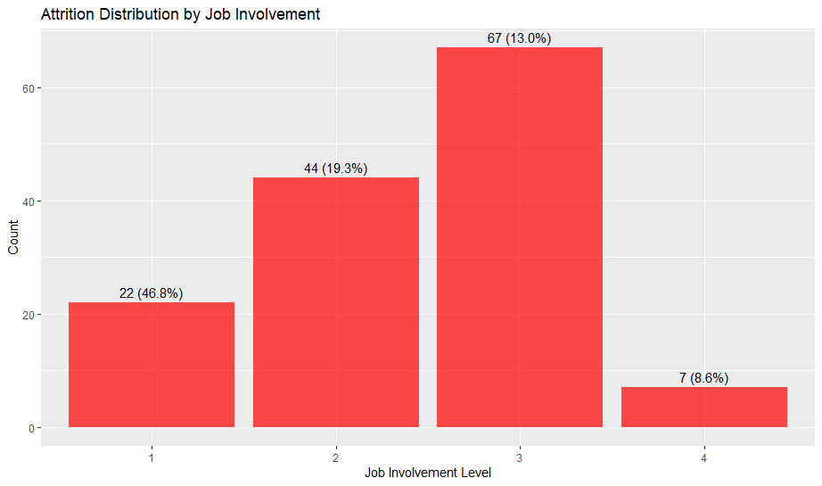
Job Involvement
Less involved employees tend to leave.

Slide 8

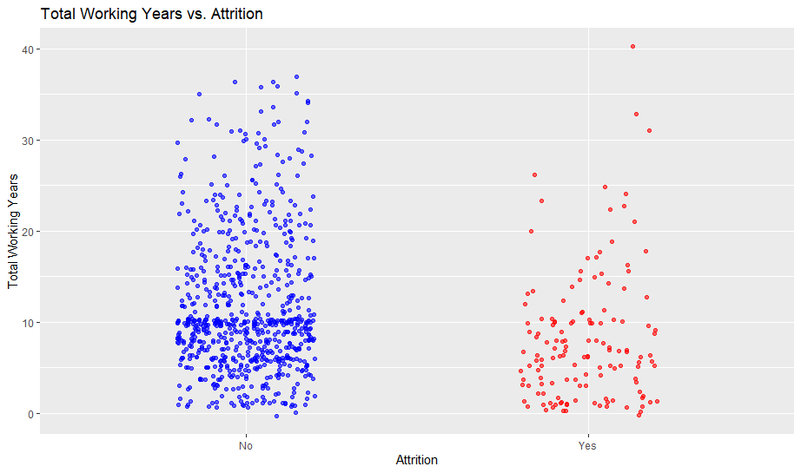
Total Working Years
Average Total Working Years of employees lost to attrition: 8.19
Average Total Working years of employees not lost to attrition: 11.6
Employees with fewer total working years tend to leave.

Slide 9
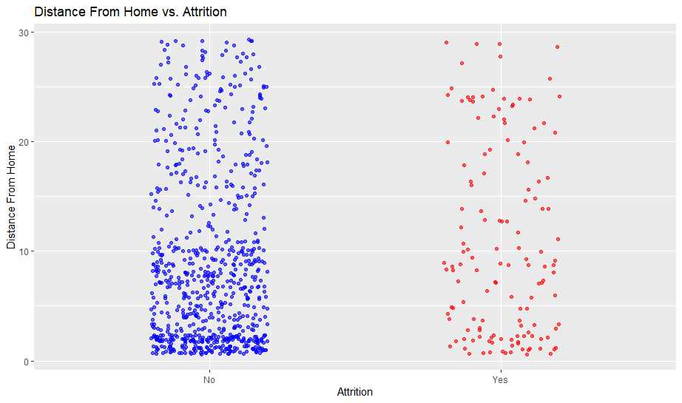
Distance from Home
Employees who live further away are more likely to leave.

Slide 10
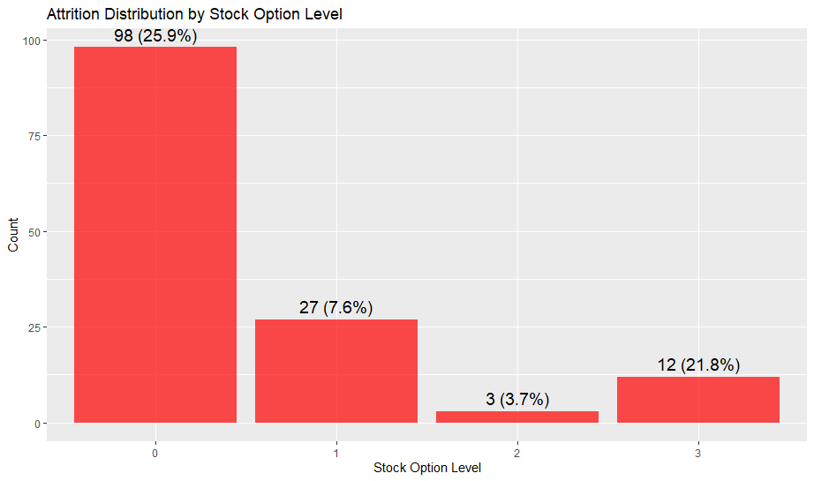
Stock Option Level
Employees not given stock options are more likely to be lost.
Possible overlap with Years At Company and Job level.

Slide 11
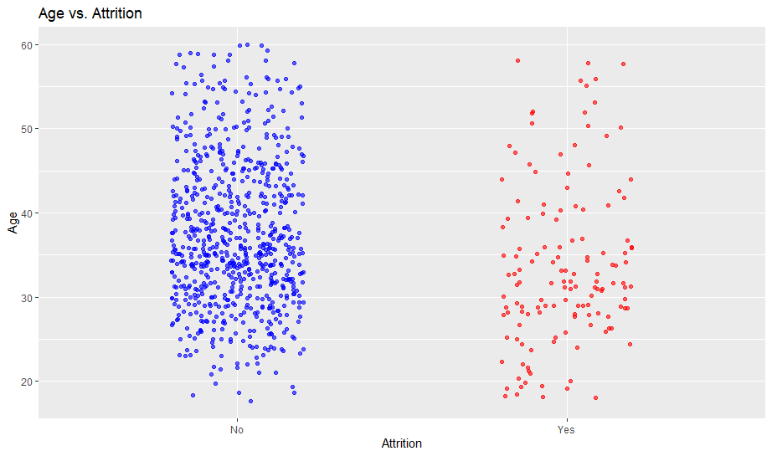
Age
33.79 average age of employees lost.
37.41 average age of employees retained.
Younger employees are more likely to be lost to attrition.

Slide 12
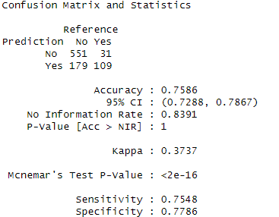
Proposed Model (KNN)
True Negatives (551): Employees correctly predicted to stay.
False Positives (179): Employees incorrectly predicted to leave but actually stayed. (Specificity)
False Negatives (31): Employees incorrectly predicted to stay but actually left. (Sensitivity)
True Positives (109): Employees correctly predicted to leave.

Slide 13
Cost Implications
Predicted Cost Before Model: $6,441,386.48 lost to attrition
Cost of Retention Incentives: $57,600
Total Estimated Cost After Model: $1,483,907.01
Total Saved: $4,957,479.47

Slide 14
Conclusion

